Slide 1
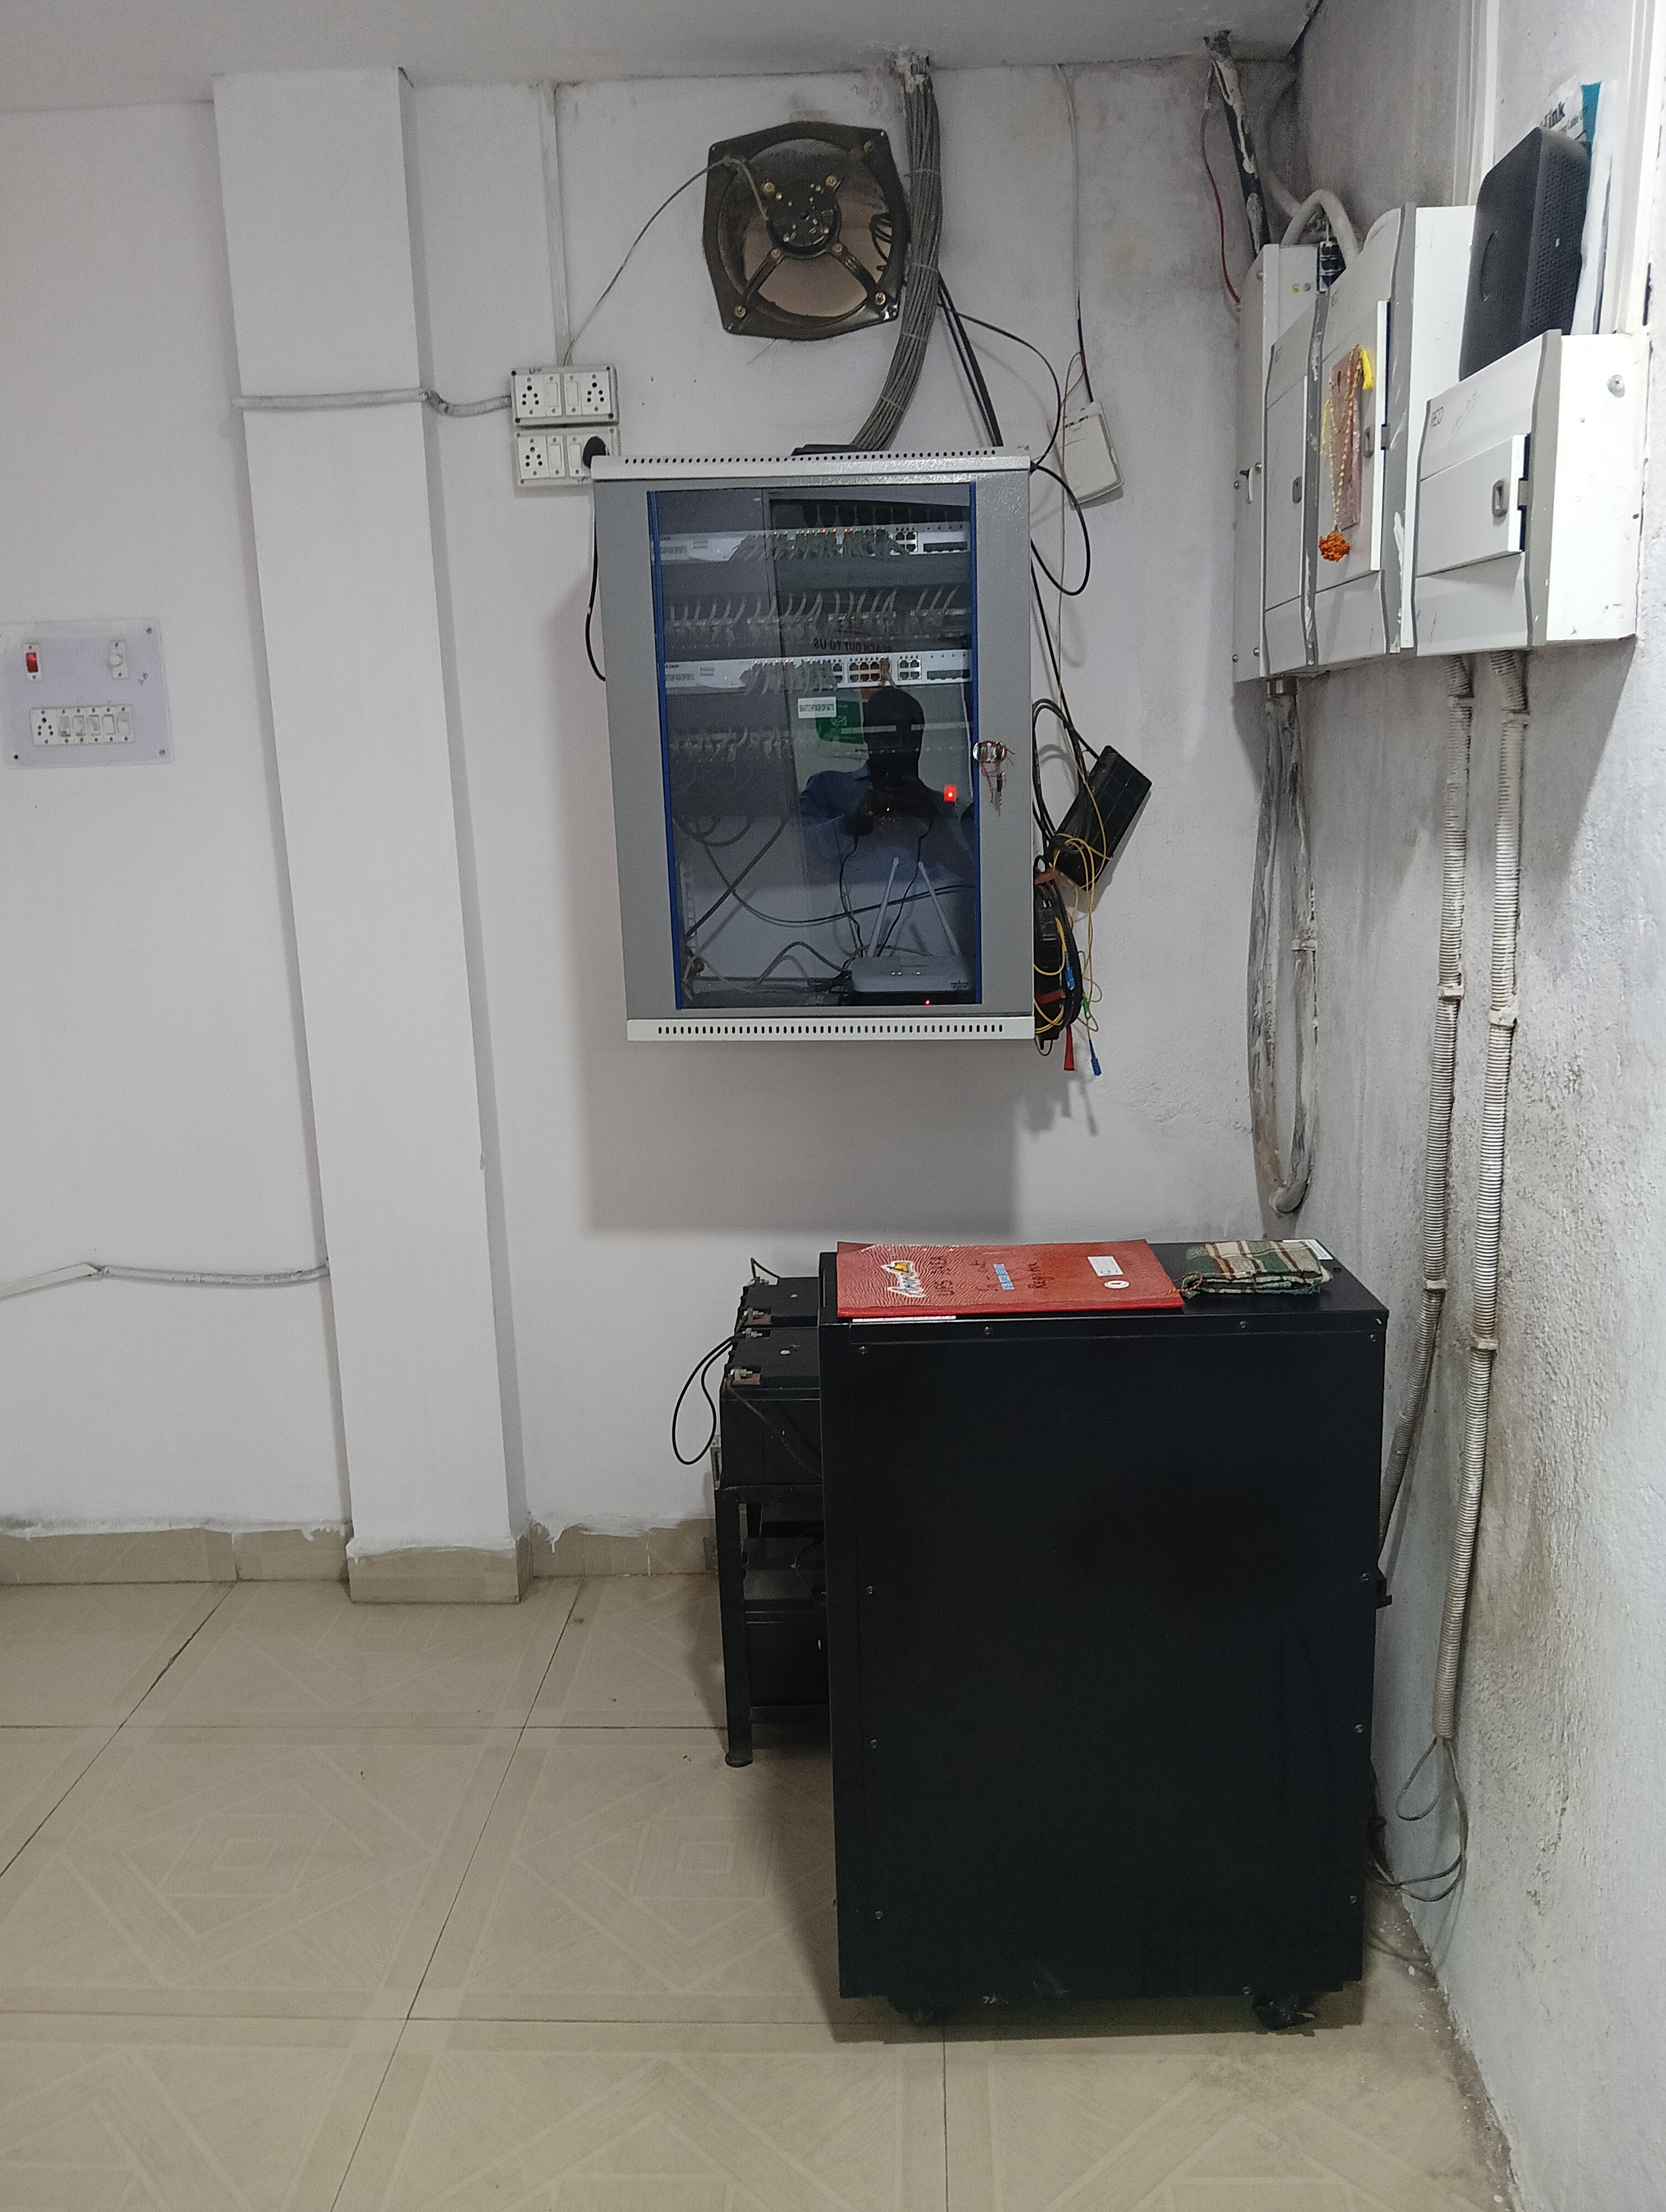
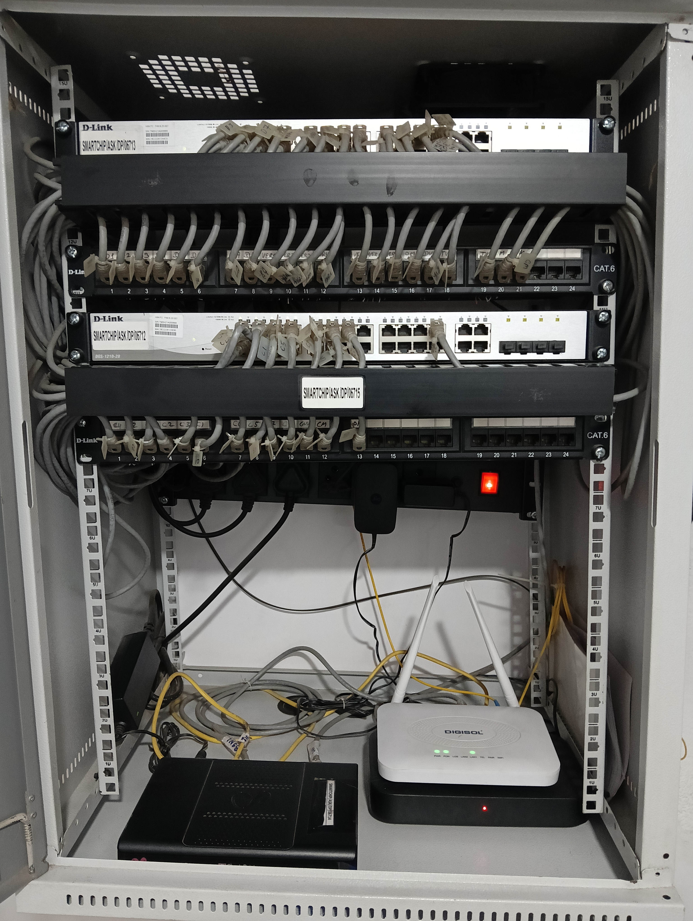
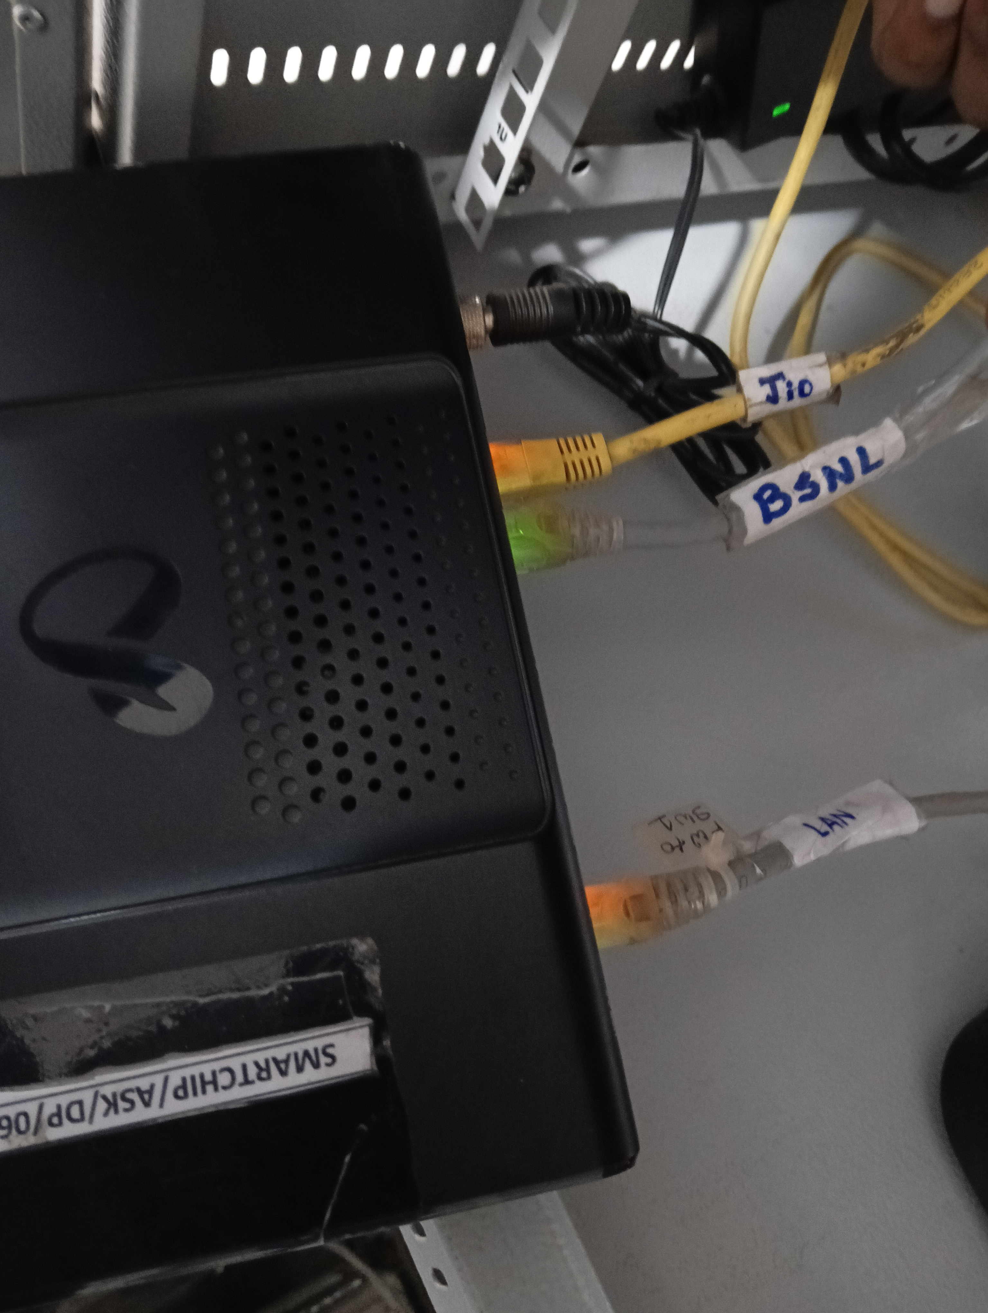
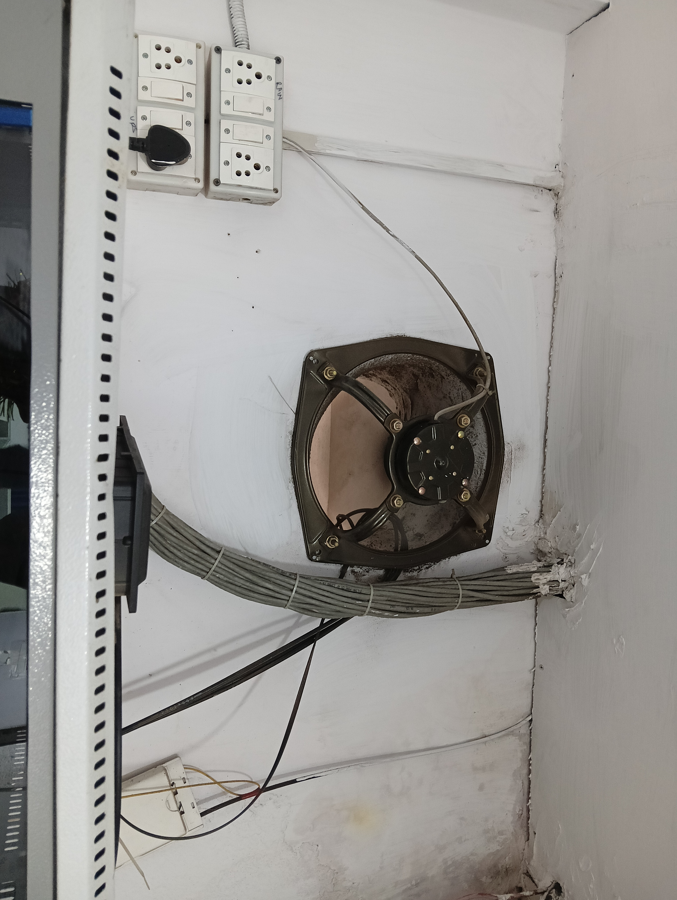
ASK JAMSHEDPUR
Center Lead – Anwar Shadad
IT L1 – Krishna Munda
Date – 23 Sep 2024
Network Room
Network Rack
Ventilation
Wire Tagging

